Slide 1
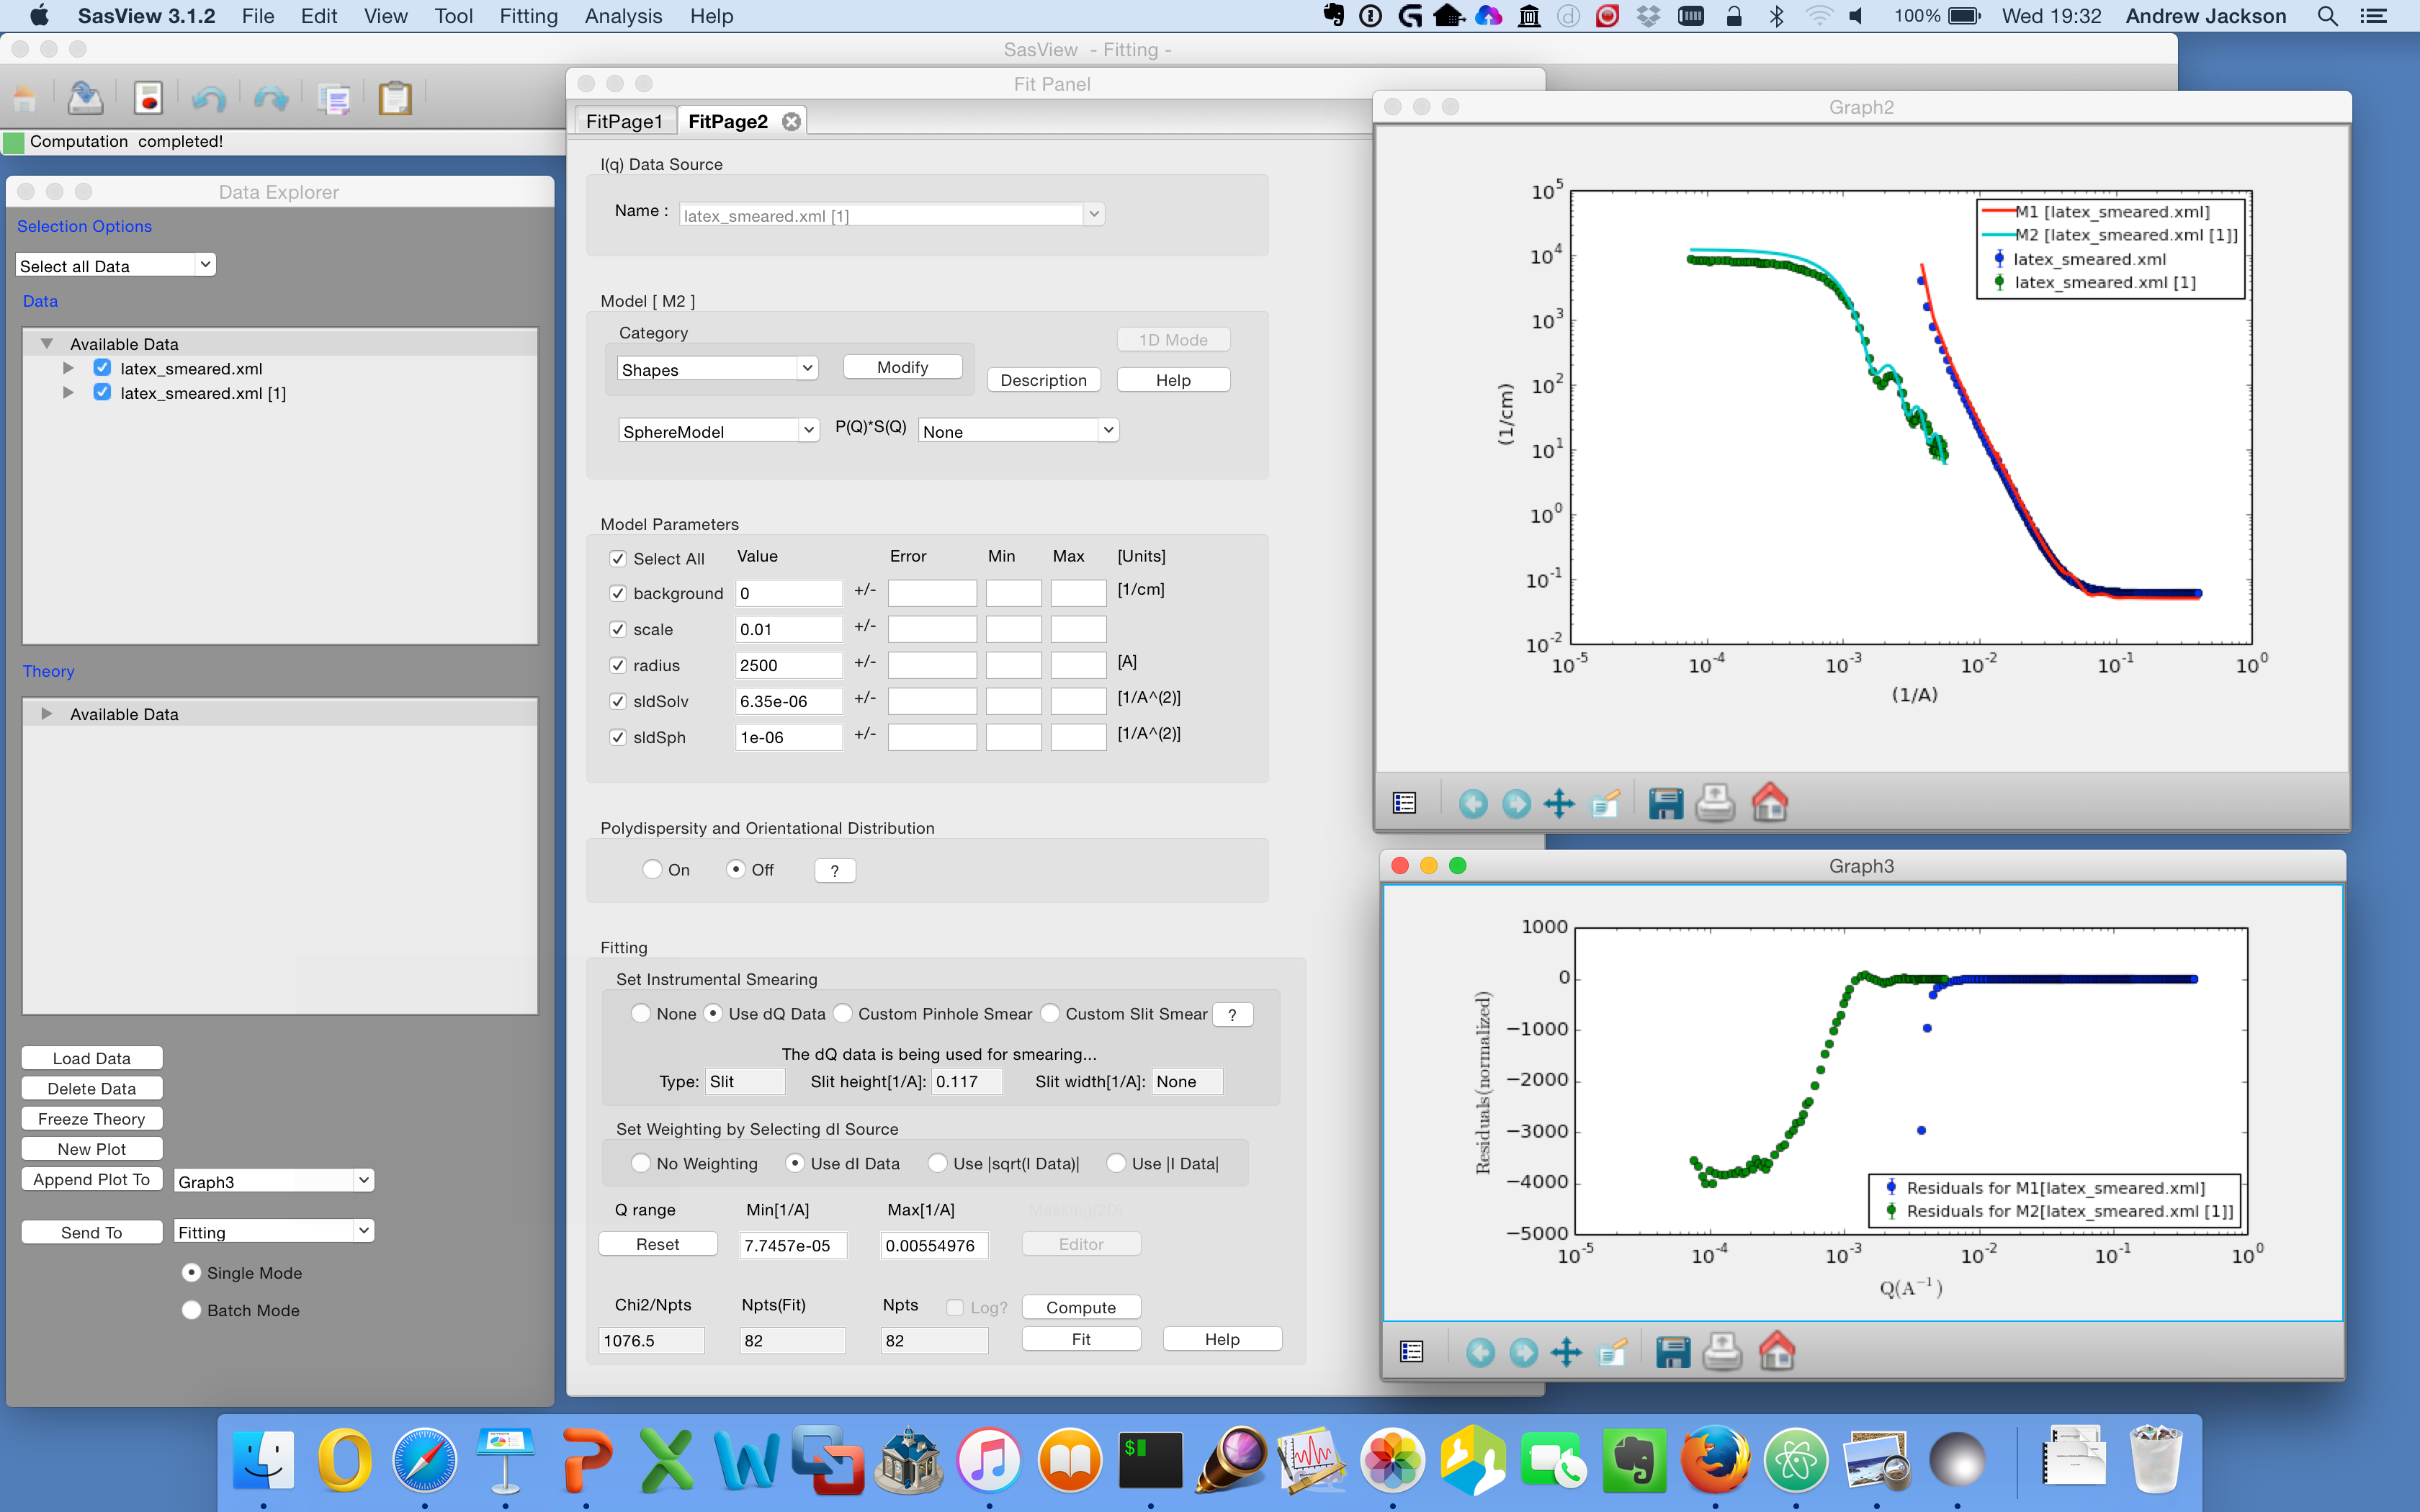
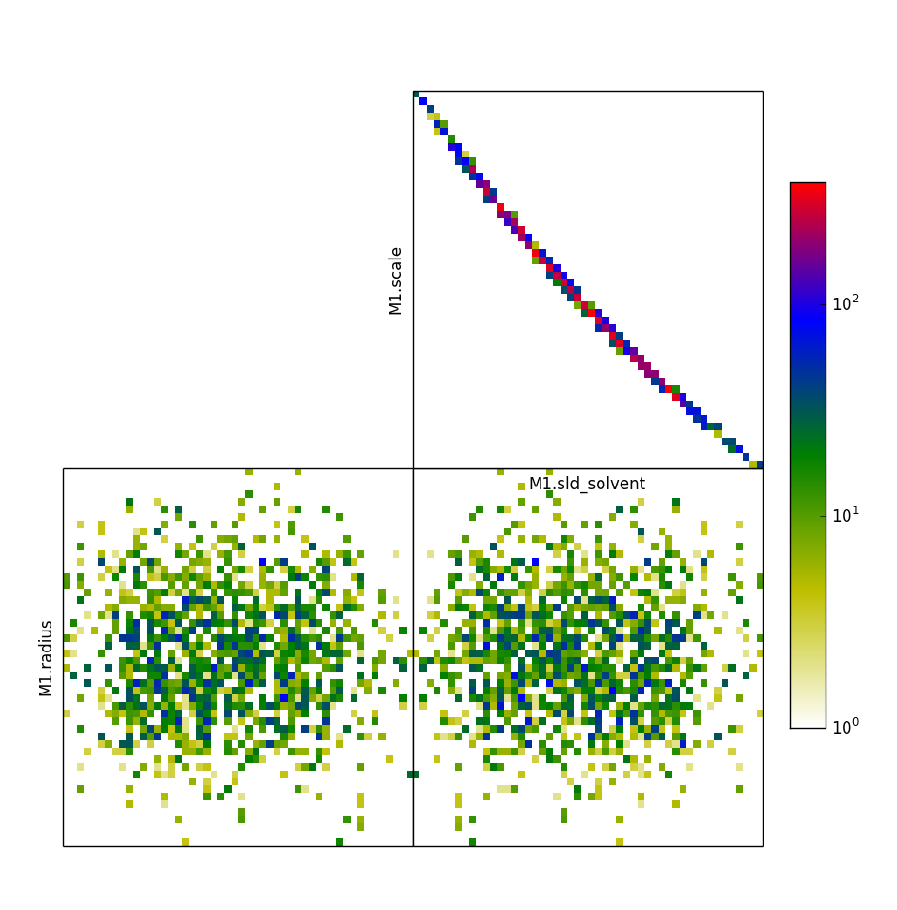
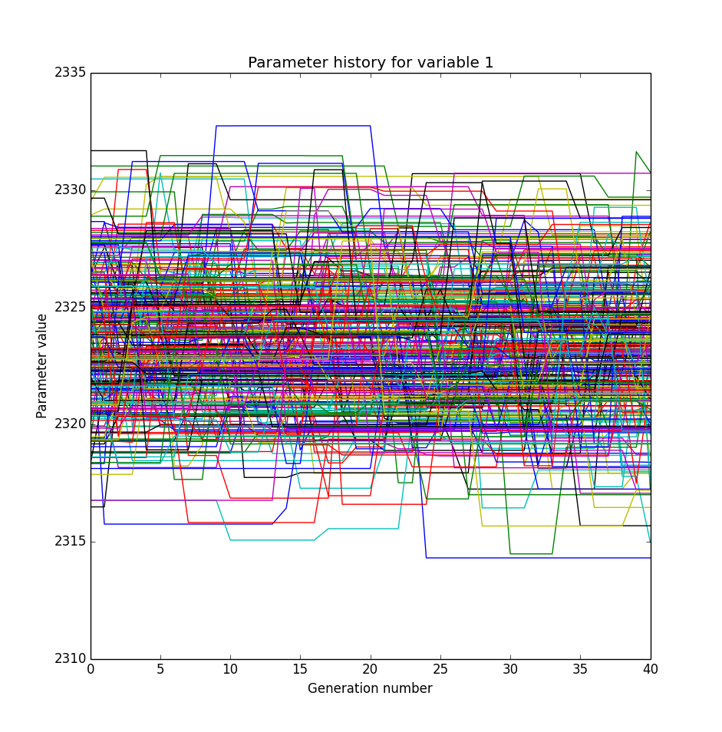
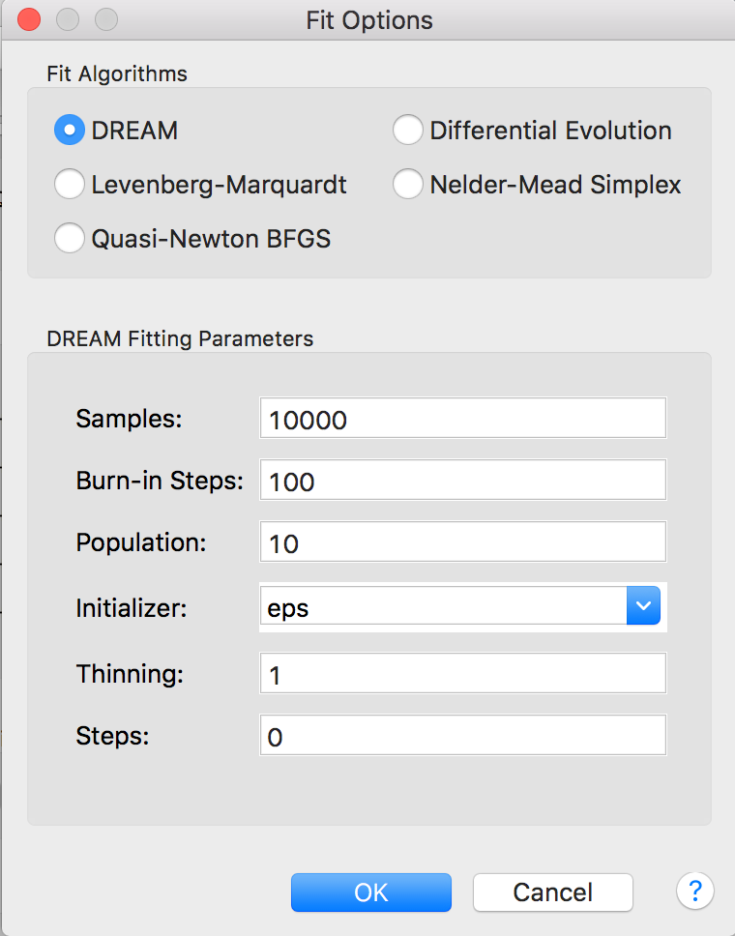
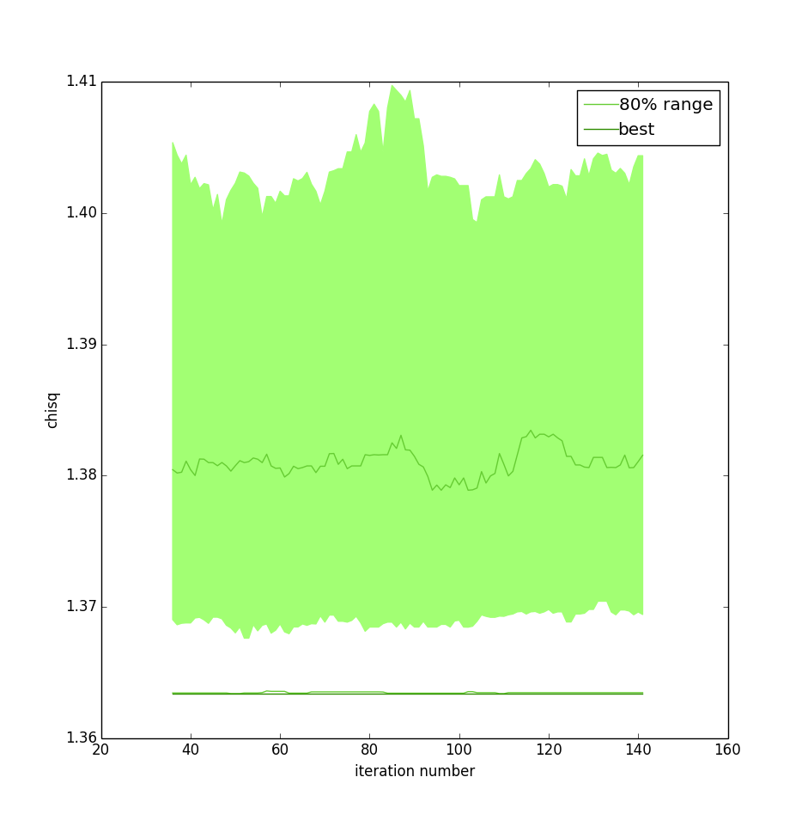
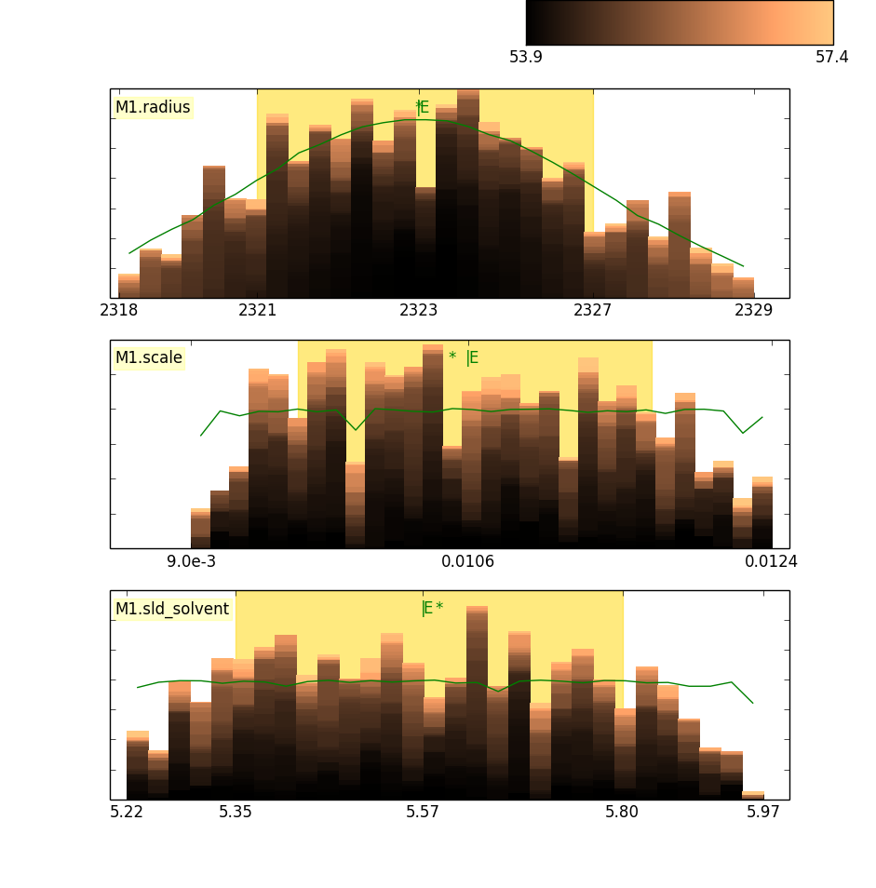







SasView : A Small Angle Scattering Analysis Software Package
Standard data formats
Analytical model fitting w/ plug and play models
SESANS support
2D and magnetic scattering
P(r) inversion
Generic PDB scattering calculator
Many other tools
GPU support
Advanced Optimizers
Open, Collaborative, Community Development
Code is open source and publicly hosted at Github
Bug and Enhancement Ticket System – Trac
https://github.com/SasVIew http://trac.sasview.org
Bi-weekly developer calls
Regular Code Camps
5 Year Roadmap
Mailing lists – see www.sasview.org
Need Help? Email help@sasview.org

